Slide 1
Chapter 11
Feasibility Analysis
and the System Proposal

Slide 2
Feasibility Analysis
Feasibility
  the measure of how beneficial or practical an information system will be to an organization
Feasibility Analysis
  the process by which feasibility is measured

Slide 3
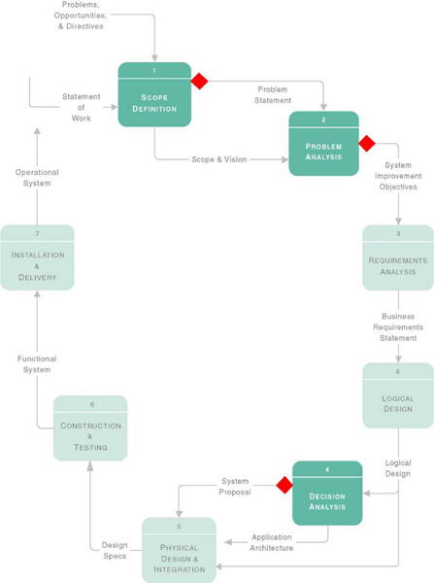
Feasibility
Checkpoints
Scope Definition
Problem Analysis
Decision Analysis

Slide 4
Tests of Feasibility
1. Operational Feasibility
2. Cultural or Political Feasibility
3. Technical Feasibility
4. Schedule Feasibility
5. Economic Feasibility
6. Legal Feasibility

Slide 5
1. Operational Feasibility
A measure of how well a solution meets the requirements to solve the problems
  Can the solution work?
  How well is the problem solved?
  How well does it satisfy the requirements?
  Is the problem still worth solving?

Slide 6
2. Cultural or Political Feasibility
A measure of how well the solution will be accepted in a given organizational climate
  Will the solution work?
  How do the users feel about the solution?
  Does management support it?
  Can resistance be overcome?
  Is the working environment being changed?

Slide 7
3. Technical Feasibility
A measure of the practicality of a technical solution and availability of technical resources and expertise
  Is the proposed solution practical?
  Do we possess the necessary technology?
  Do we possess the necessary expertise?

Slide 8
4. Schedule Feasibility
A measure of the reasonableness of a project timetable
  Are the deadline mandatory?
  Are the project deadlines reasonable?
  It is preferable to deliver a properly functioning system late than to deliver an error-prone, useless system on time which would be disastrous!

Slide 9
5. Economic Feasibility
A measure of the cost-effectiveness of a project or solution
  Once specific requirements and solutions have been identified, the costs and benefits of each alternative can be weighed … a cost-benefit analysis.

Slide 10
6. Legal Feasibility
A measure of how well a solution can be implemented within existing legal limits and contractual obligations
  Are license agreements being violated?
  Who owns the source code?
  Is a non-disclosure agreement in place?

Slide 11
Costs
Development Costs
  one time costs that will not recur after the project has been completed
Operational Costs
  costs that recur throughout the lifetime of the system
Fixed Costs
  costs that occur at regular intervals and at a relatively fixed rate (e.g. lease payments)
Variable Costs
  costs that occur in proportion to some usage factor (e.g. supplies)

Slide 12
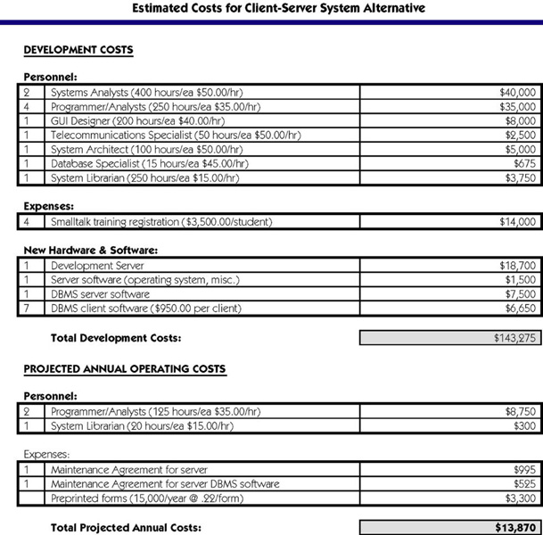

Slide 13
Benefits
Tangible Benefits
  benefits that can be easily quantified (e.g. decreased response time)
Intangible Benefits
  benefits that are believed to be difficult or impossible to quantify (e.g. morale)

Slide 14
Cost-Effectiveness
Payback Analysis
Return-on-Investment Analysis
Net Present Value
All share the concept of Time Value of Money … A dollar today is worth more than a dollar one year from now.

Slide 15
Payback Analysis
A Payback analysis determines how much time will elapse, the payback period, before accrued benefits overtake accrued and continuing costs.

Slide 16
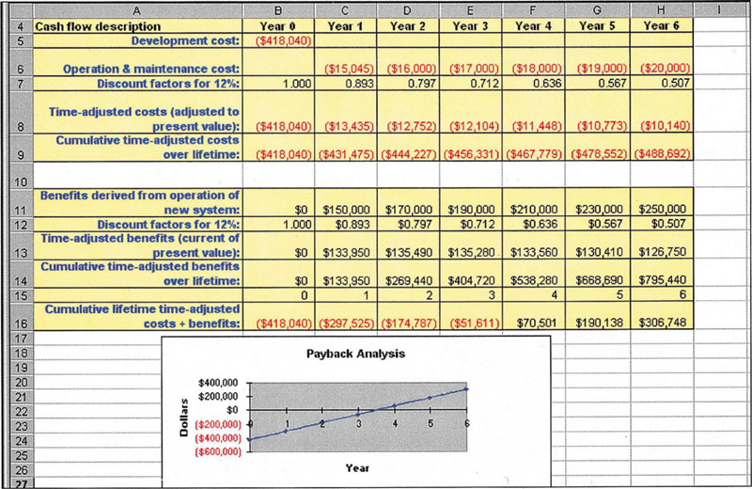
Payback Analysis

Slide 17
Return-on-Investment Analysis
The Return-on-Investment for a solution is a percentage rate that measures the relationship between:
a) the amount the business gets back from an investment, and
b) the amount invested

Slide 18
Net Present Value
The Net Present Value of an investment compares the annual discounted costs and benefits of alternative solutions.

Slide 19
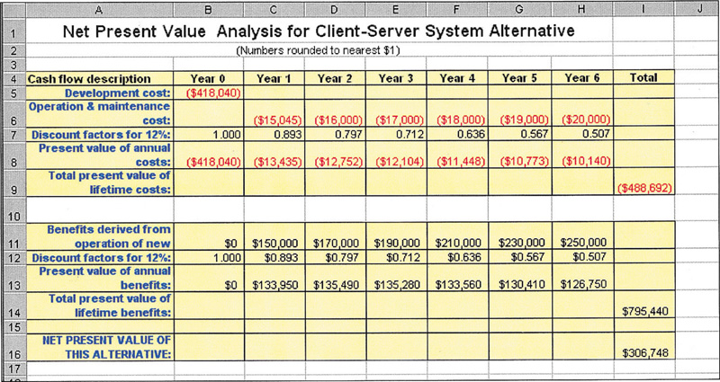
Net Present Value

Slide 20
Feasibility Analysis Matrix
 | Weight | Candidate 1 | Candidate 2 | Candidate 3
Description
Operational Feasibility
Cultural Feasibility
Technical Feasibility
Schedule Feasibility
Economic Feasibility
Legal Feasibility
Ranking

